Slide 1
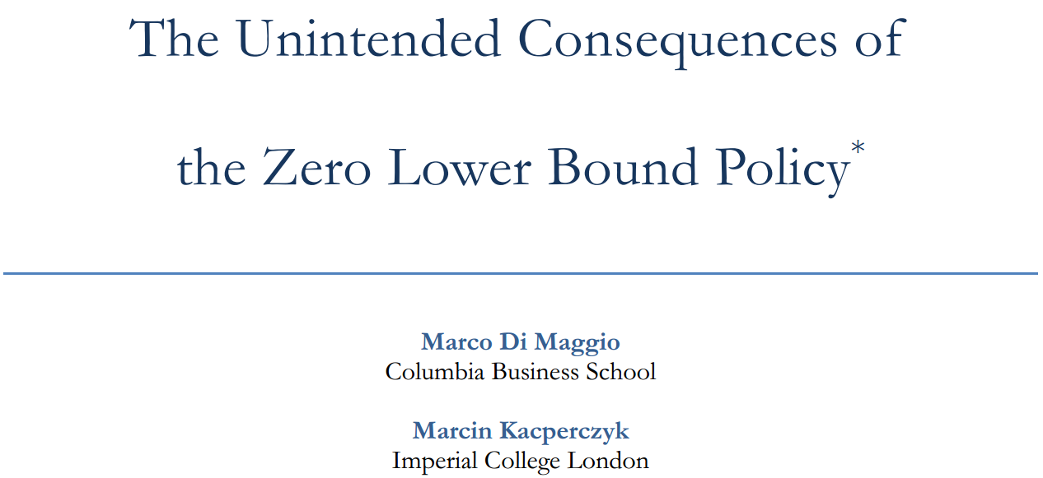
Presentation by Shaoyuan Yang
Instructed by Phil Dybvig

Slide 2


Authors
Marco Di Maggio.
Marco is now a professor of business administration in Harvard Business School. Before joining HBS, he was a faculty member in finance and economics division of Columbia Business School. He is focusing in the area of fintech, as well as how new technologies have disrupted the financial markets, and how the impacts would effect firms and individuals.
Marcin Kacpercsyk.
Marcin has been a professor of finance in Imperial College London, Business School since 2013. Before that, he has been teaching in the Stern School of Business, New York University. His research Interests focus on investments, institutional investors, behavior finance, and decision theory, etc.

Slide 3
Contents
Introduction
Research Design and Data
Empirical Results
Robustness Checks
Conclusion

Slide 4
Introduction

Slide 5
Introduction
Fed rate: short term interest rates such as the rate of T-bills. It is decided by the US Federal Reserve.
Money Market Fund (MMF), or so to speak Money Fund, for the reason of regulation, can only invest in some short-term assets with rates of return that are close to the Fed funds rate. Therefore, MMFs are key buyers of some short-term debt issued by banks and corporations, such as commercial paper, bank certificates, and repurchase
agreements, with an aggregate amount of $1.8 trillion. Different from some high yields assets such as stocks and
corporate debts, these short-term assets have lower risk thus have a narrower spread / gap of interest rate difference
compared with the Fed rate.
A Monetary Policy Shock: as a consequences of the financial crisis of 2007-2008, the Federal Reserve took an special measure to lower short-term nominal interest rates (Fed rate) to the level close to zero, this shock would drive the fund’s short-term assets’ gross return nearly to zero, squeeze the gross margin of MMF, and bring some negative impacts to MMFs.

Slide 6
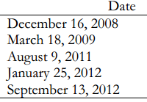
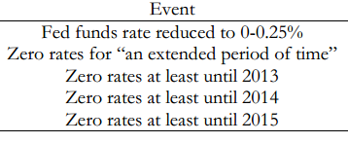
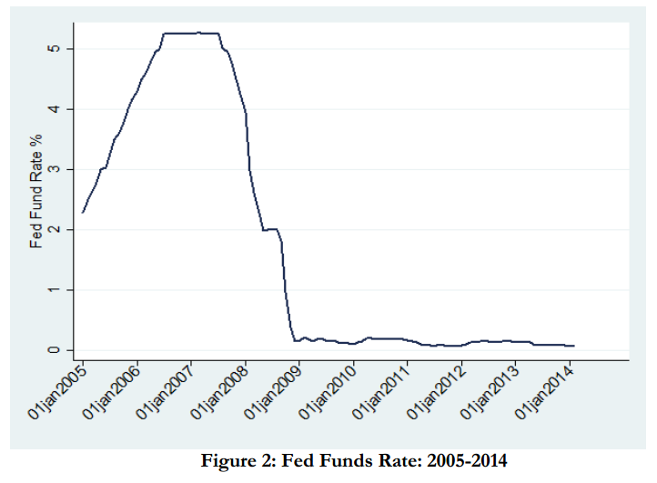
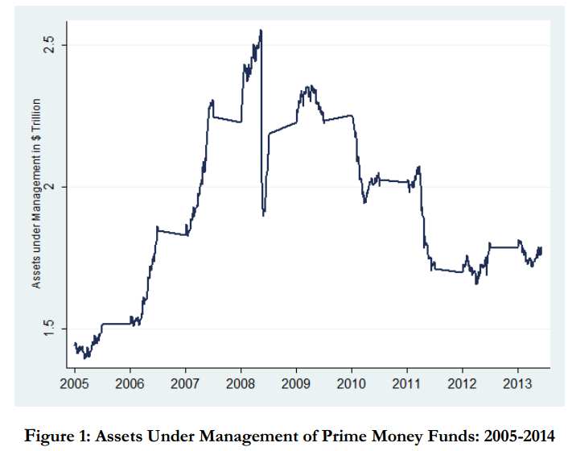
Introduction
The authors have studied the impact of the zero lower bound interest rate policy on US money fund industry.
…and this is just one of the adverse impacts to MMFs.
The paper will further study how the policy will negatively affect the behaviors of MMFs.
Notes:
Explain zero interest rate
Explain what is money fund

Slide 7
Introduction
Dilemma for Money Market Funds under zero Fed rate
On one hand, MMFs can just accept the situation and keep their risk profiles unchanged. However, since their spreads (as well as fund return) were deeply cut down, to retain the attractiveness to their customers, MMFs have to lower their fees charged on their customers. And in the end, if the zero lower rates persist for a very long time, MMFs will not be able to withstand the pressure and will be forced to exit the market.
On the other hand, MMFs could just reach for higher yields and returns by shifting their risk into securities with higher interest rates, and accept the assets with higher risk profiles.

Slide 8
Research Design and Data

Slide 9
Research Design and Data
Main Idea
In the time series, the authors measured the probability of exit from the MMF industry, risk taking, expenses charged by MMFs in the period of three to six months after the announcements (Event of each Federal meeting).
In the cross section, the authors divide MMFs into two types: 1. the independent funds, that is, funds whose sponsors are not affiliated with insurance company, commercial, or investment bank 2. the funds who did affiliated with these large corporations. The authors want to find out that which type of MMF has a higher chance of reaching for higher yield.
Events-Driven, in authors’ analysis, they focus on the MMFs’ behavior around events related to FOMC meetings
during which at least one of the following outcomes occurred: (1) a change in the interest rates, (2) forward guidance
announcement.
Notes:
Explain why duration matters: Authors believe the forward guidance policy affects the duration of zero-rate policy. The time period of the duration, either short or long, will for sure have different impacts on the equilibrium implications on MMFs. MMFs may live through a short period of zero interest rates, but will be extremely difficult to withstand the pressure of a long period of zero interest rate.

Slide 10
Research Design and Data
This paper does not consider QE (Quantitative Easing)
QE is an important policy which impacts the interest rate in a notable way, however, the authors do not consider QE
here for two reasons:
First, QE interventions mainly target at the long-term part of yield curve, but all the assets MMFs are allowed to hold are short-term assets whose maximum maturity is less than 45 days.
Second, QE primarily purchase mortgage-backed securities, yet, MMFs are not allowed to hold these securities due to regulatory constrains.
Two time windows
The analysis of the paper requires constructing reasonable windows around the event dates. Given that various MMFs’
strategies can be adopted with different speed, the authors consider two horizons: a short horizon of three months,
and a long horizon of six months after the event. In both cases, the pre-event window is set at one month to ensure
that no pre-event trends drive the patterns in the data. The empirical strategy is to compare the average fund behavior
around the event dates.
Notes:
Reason for setting up a longer window is that sometimes MMFs’ strategies may take longer time to come into effect.

Slide 11
Research Design and Data
Data
1. iMoneyNet : cover the period from 2005.01-2013.12 including weekly fund-level data on yields, expense ratios
(charged and incurred), average maturity, holdings by instrument type, and fund sponsor.
2. CRSP Mutual Fund Database : assets under management and entry/ exit of other funds.
3. COMPUSTAT and companies’ websites : information on fund sponsor characteristics (Affiliated or Independent）
4. Investor Observer, LinkedIn, Morntngstar, Zabasearch, and Zoominfo : data on fund managers.
5. Federal Reserve Board website : information about Fed funds rate changes and forwards guidance policy.

Slide 12
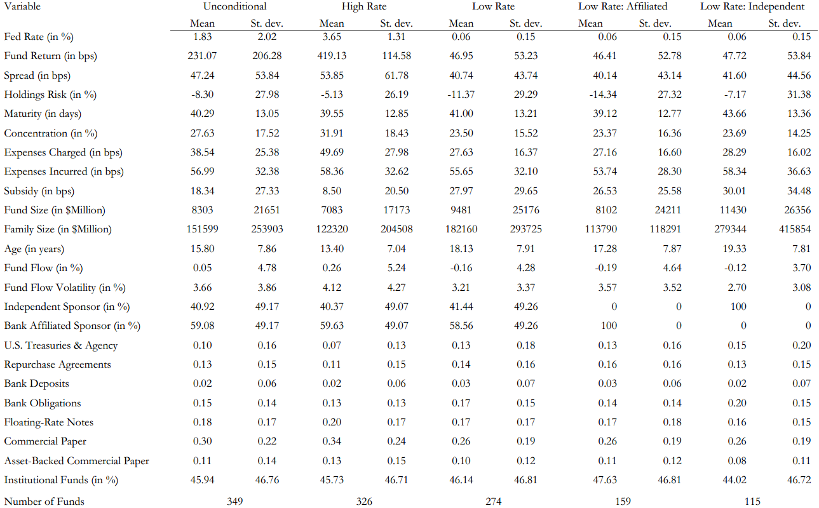
Notes:
1. The spread (or so to speak “abnormal profit”) during the low rate period is 25% lower than in the high rate period. The nominal gross return is almost 10 times larger in the high-rate period, this suggest that MMFs face greater challenges in obtaining high returns in a low interest rate environment.
2. if we look at expenses charged they are significantly lower in the low-rate period, with a drop from 50 to 28 basis points, while expenses incurred remain almost the same. This suggests that while the costs are not affected by the monetary policy, the stress imposed on the profit margin reduces the possibility for a fund to charge fees to investors. In other words, funds are more likely to offer subsidies to their fund investors.
3. while fund flows are positive during the earlier period, they become negative in the low interest rate environment. This is consistent with the idea that investors have become less willing to make investments in MMFs as their returns became less attractive.
4. we observe a significant decline of more than 50 in the number of funds over the two periods: from 326 to 274 funds in the second period, which constitutes a significant exit from the sector.

Slide 13
Empirical Results

Slide 14
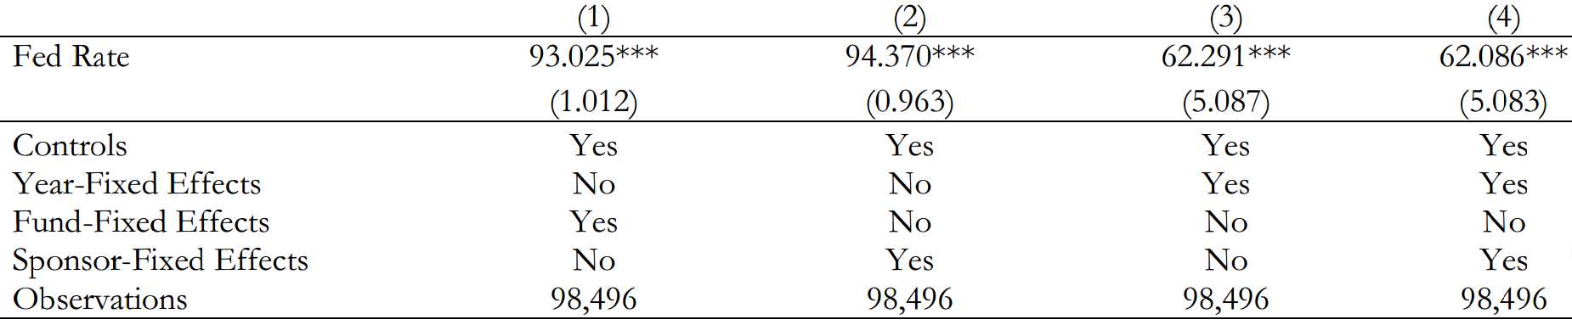
Empirical Results
1.Asset Returns
Control variables: Log(Fund Size), Expenses, fund age, Fund Flow, Fund Flow Volatility
Fund and sponsor fixed effects: to account for time-invariant fund and sponsor characteristics.
Year-fixed effects: to address a potential concern that interest rates might proxy for general macro trends
Conclusion: The results show that fund performance improves in periods of high interest rates. The effect is statistically and economically highly significant. It is consistent with our hypothesis that assets held by MMFs are highly correlated with the level of short-term rates.
All regressions are at the weekly level. ***, **, * represent 1%, 5%, and 10% significance, respectively.
Notes:
We begin to identify the link in the data, between Fund return and Fed rate.
(click) We estimate the regression model of fund gross returns (Fund Return) on the Fed funds rate (Fed Rate) over our sample period.
Coefficients are all positive, meaning that fund performance improves in periods of high interest rates.
They are all 3 stars, meaning the results are statistically significant.
This is consistent with our hypothesis that assets held by MMFs are highly correlated with the level of short term-rates.
In sum, the results underscore the importance of interest rates for generating fund performance.

Slide 15
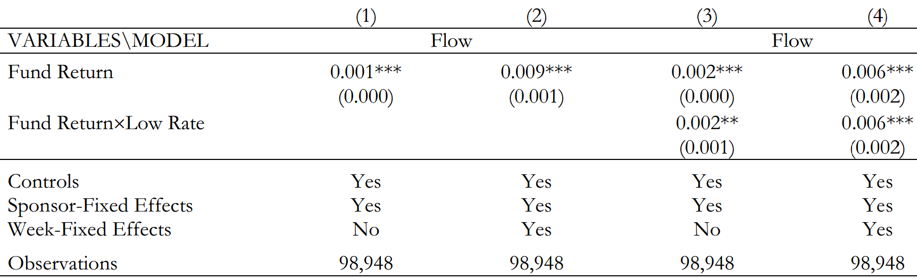
Empirical Results
2. Fund Flows (computed as a percentage change in total net assets of MMFs)
Conclusion:
1. Investors exhibit strong sensitivity to fund’s past returns. Form (1) and (2), the coefficient is positive and significant, meaning that when Fund Return decreases, the dependent variable Fund Flow will be negative, meaning that investors will leave MMFs.
Notes:
Fund Flows: positive means increase, negative means decrease
Likewise, we control for X, and we set some sponsor-fixed effects and week-fixed affects.

Slide 16
Empirical Results
Next, we aim to understand if there is any non-linearity in this flow-performance relationship as Fed rate approaches the zero lower bound. Thus, in (3)&(4), we introduce an indicator Low Rate, which will equal to 1 when Fed rate is less than 1%, and 0 otherwise.
Conclusion: The flow-performance relationship is stronger in periods of low interest rates as the coefficient of the interaction term is positive and highly significant. From (3), we observe that investors are about twice as sensitive to changes in fund performance during the period of Low Rate. This further underscores the need for funds to adjust their operating strategies along various dimensions, such as exit, risk taking, and cost policy.

Slide 17
Empirical Results
In this section, authors evaluate MMFs’ behavior around the forward-guidance policy announcements using an event-study methodology.
1. They first analyze changes in fund behavior in the time series—before and after FOMC events.
2. Subsequently, they explore the cross-section of MMFs with respect to their sponsor types.

Slide 18
Empirical Results
Time-Series Evidence
The authors use a generic dependent variable, Fund Strategy, to measure three dimensions of fund adjustments: exit, risk taking, and expense policy.
Our independent variable of interest in all tests is Event, an indicator variable equal to 1 for the period after the event date (short or long), and 0 beforehand. They also include a set of controls like before.
These are measured as of January 2006 to account for any endogenous movement in observables due to monetary shocks.
Notes:
Dependent variable: Fund Strategy includes three types of strategies: exit, risk, and expense
Independent variable is Event, which keeps track of the Federal reserve meeting.

Slide 19
Empirical Results
Time-Series Evidence – exit strategy
Fund Strategy now stands for the dependent variables # Funds and Exit.
# Funds defined as the number of MMFs available in week t.
Exit, defined as an indicator variable equal to 1 if the fund sponsor closes its fund in week t, and 0 otherwise.

Slide 20
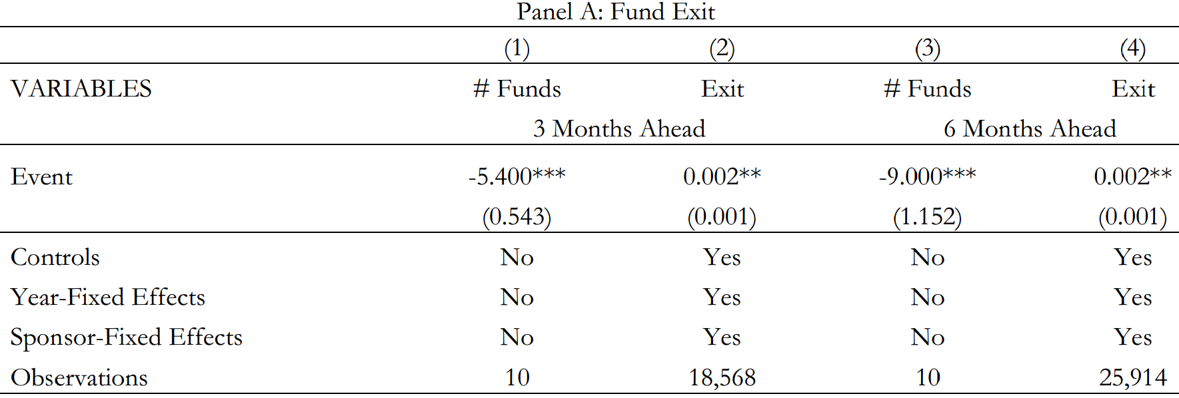
Empirical Results
Conclusion:
1. The authors find that, on average, 5 and 9 funds drop after the policy event within the shorter and longer horizons, respectively. This is an economically large effect that, if cumulated over five events, brings the total to more than 25 and 45 of lost funds.
2. The funds leaving the market are often large funds, which corroborates our findings in Figure 1 of declining aggregated assets under management.
3. Similarly, we find that the probability of exiting the fund industry increases significantly in both horizons following the event.
Notes:
The funds leaving must be large funds, otherwise there would not be a sharp decline of money under management of MMFs in the later period. Therefore, since the funds that leave are large, thus the impacts they bring is not trivial.

Slide 21
Empirical Results
Time-Series Evidence – risk taking strategy
The authors use four different risk measures.
Spread is the difference between Fund Return and the T-bill rate;
Holdings Risk is a difference in fund weights in the riskiest asset class (bank obligations) and the safest asset class (Repos and U.S. Treasuries and Agency assets);
Maturity Risk is the weighted average maturity of the fund;
Concentration is a Herfindahl index of the portfolio holdings in risky assets, such as commercial paper, asset-backed commercial paper, floating-rate notes, and bank obligations.
· Higher values of each measure indicate a greater degree of risk taking.

Slide 22
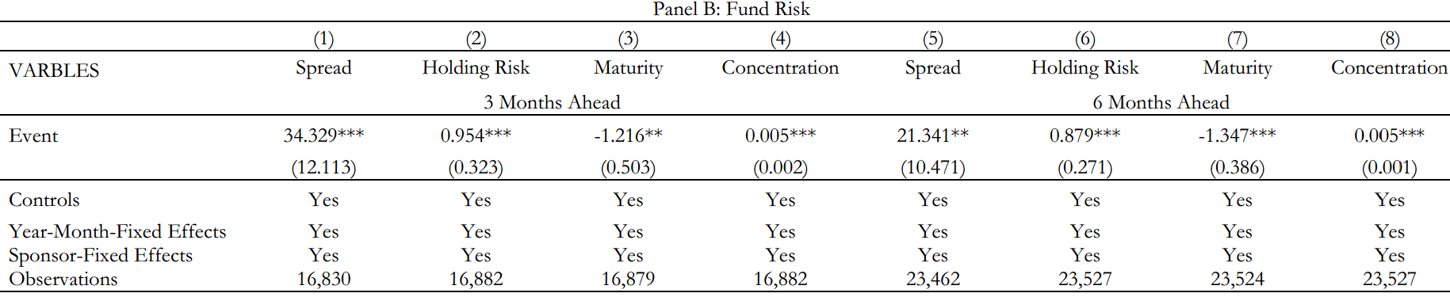
Empirical Results
Conclusion:
The authors find that as a result of the policy announcements, 3 out of 4 measures of fund risk increase for both investment horizons. This indicates that MMFs tend to take higher risk after the announcement of “low-rate” policies by Federal reserve.
The only risk measure that goes down is Maturity Risk. This difference is likely driven by the provision in the Dodd-Frank Act, which implemented a significantly higher lower bound for the fraction of assets maturing within the next seven days that MMFs need to hold.
Comparing the results in columns (1)-(4) to those in (5)-(8) suggests that the risk profile of MMF industry depends on the policy announcements, and much of the risk adjustment happens quickly.
Notes:
“Happen quickly” because the spread and holding risk coefficients are both higher in 3-month window compare to 6-month window.

Slide 23
Empirical Results
Time-Series Evidence – expense policy
The authors hypothesis that in the wake of low interest rates and low fund returns fund companies would want to maintain their client relationship by reducing the fees they charge, thus effectively increasing these investors’ net of fees returns.
At the same time, there is no reason to believe that expenses truly incurred by funds would change. Consequently, by lowering their fees to investors, fund companies would offer subsidies to their investors. In the paper, we measure the degree of such subsidies by taking the difference between incurred and charged expenses.
Incurred expense: the fees investors should pay
(-) Charged expense: the fees investors actually pay
(=)Subsidies offered: the subsidies MMFs offered to customers

Slide 24
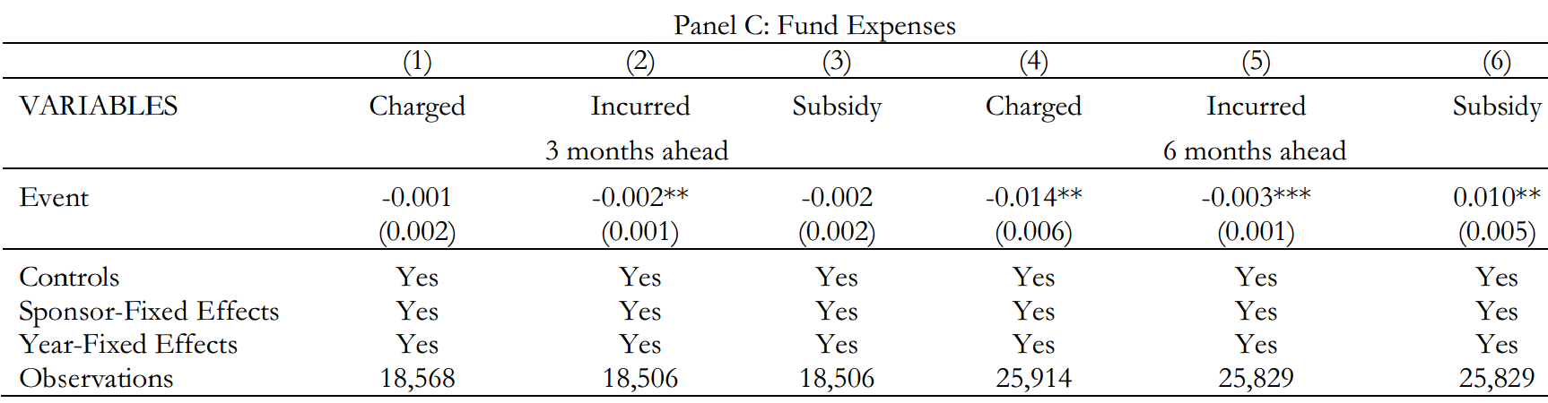
Empirical Results
Conclusion:
The authors find a significant reduction in expenses charged, and a significant increase in fund subsidies in response to FOMC announcements.
These effects are particularly strong for the longer, six-month window, which might reflect some sluggishness with which fund companies respond in terms of their pricing policies.
The authors find no differences in fund incurred expenses in response to the announced policies.

Slide 25
Empirical Results
Cross - Sectional Evidence
There are two types of sponsors: institutional ones which affiliated with large institutions and independent ones.
In this section, the authors shed more light on the economic mechanism by exploiting a sponsor level variation in incentives to respond to profit margin squeeze. They hypothesize that fund sponsors with greater reputation concerns might want to internalize the negative spillovers by either taking less risk or leaving the fund industry altogether. They might also entertain different pricing strategies.
They argue that one way to measure reputation concerns is whether a fund is sponsored by a financial institution (large
reputation concerns) or is sponsored by an independent asset management company (less reputation concerns).

Slide 26
Empirical Results
Cross - Sectional Evidence
In this model, Independent Sponsor is an indicator variable equal to 1 if the sponsor is an independent management company and 0 if it is an affiliated company.
Fund Strategy and X are defined as in previous models.
The incremental effect of change with respect to sponsor type is measured by the coefficient of the interaction term Event x Independent Sponsor.

Slide 27
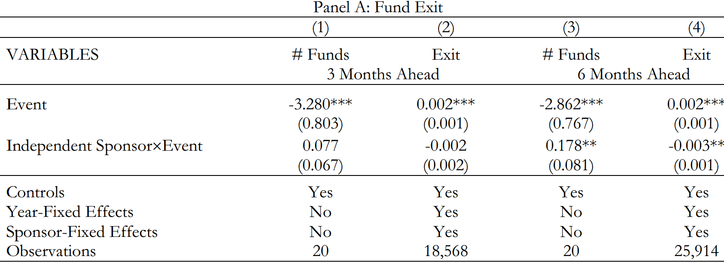
Empirical Results
Conclusion:
The authors find that funds sponsored by independent companies are more likely to stay following the policy announcement. This result is particularly strong for the six-month window, which could be due to the fact that adjustments, such as exit take longer to materialize.

Slide 28
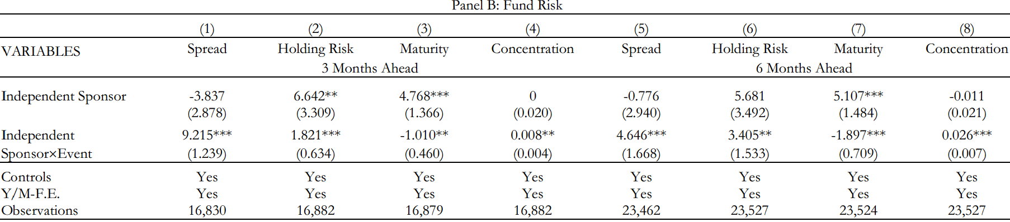
Empirical Results
Conclusion:
The authors consider various measures of fund risk. The results generally paint a picture that funds sponsored by independent asset management companies take on more risk following the change in the interest rate policy. This result holds for three out of four measures or risk. The risk adjustment already takes place within the shorter three-month period.

Slide 29
Empirical Results
The results on exit and risk taking are consistent with authors’ hypothesis that reputation concerns are driving strategic adjustments of MMFs.
Moreover, a combination of the two results implies an additional industry effect. Given that safer, affiliated funds are more likely to leave and more sensitive to risk, and independent funds are more likely to stay, this mechanism leads to a negative selection of funds that stay after the policy events.
This, in turn, makes the entire MMF industry less stable.

Slide 30
Robustness Checks

Slide 31
Robustness Checks
1. Rule out the impacts from the survivorship effects
The results we just show in this previous formulas suggest that fund risk goes up as a result of policy announcements.
To understand these findings, it is important to isolate their driving forces. In particular, the average yields in the MMF sample can increase for two reasons:
Average fund yields go up because of negative selection that retains more risky funds in the data;
(2) MMFs strategically adjust their risk in response to policies.
Our results so far, suggest the first channel is partially operating given that riskier funds are more likely to stay.
In this section, we check to what extent the second channel also contributes to our average results.
Let’s rule out the impacts from the survivorship effects and see what will happen…
Notes:
Negative selection means that due to the survivorship effects, the pool of MMFs in the market will naturally become those who are riskier.
The second arguments that even without the survivorship effects, MMFs will respond to the interest rate policy announcements.

Slide 32
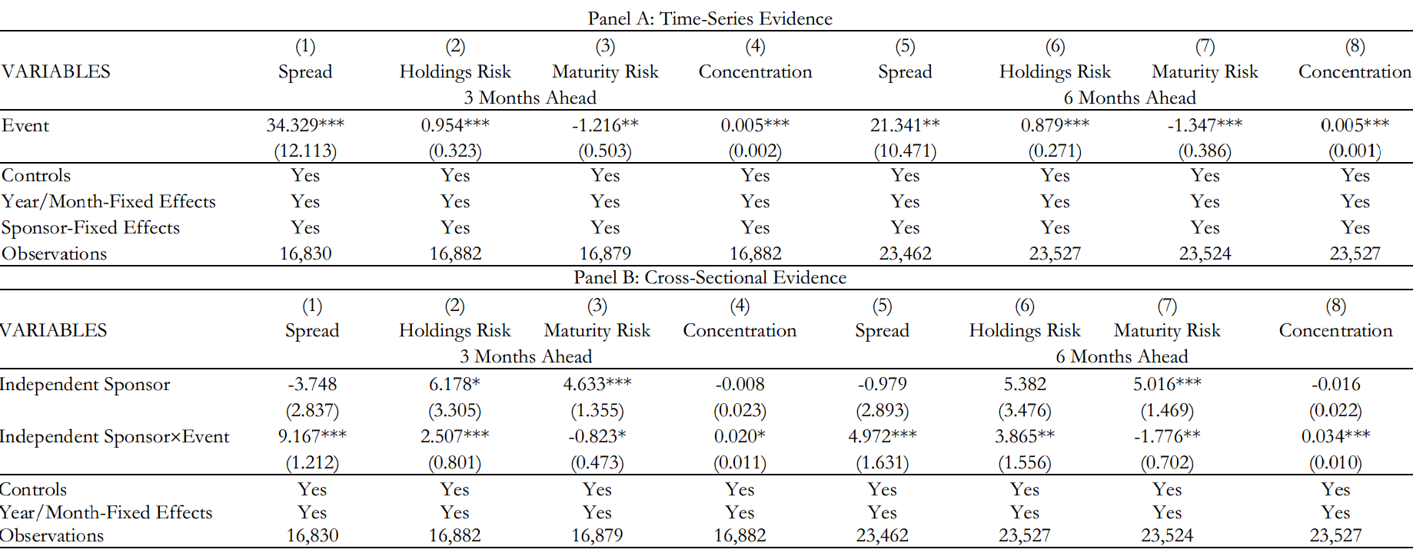
Robustness Checks
1. Rule out the impacts from the survivorship effects
How?
The authors address this issue using a subset of funds that are present in both periods of the event study. Conditioning on surviving funds makes the selection issue obsolete.
In Panel A, it reports results for the time-series effect and in Panel B for the cross-sectional effect.
Conclusion: The results from the two models are qualitatively similar to those we reported before. Hence, both economic mechanisms might be jointly responsible for the average risk effects in the data.

Slide 33
Robustness Checks
2. Evidence from Portfolio Holdings
In this section, the authors use data on fund holdings to argue that the results are driven by active portfolio decisions rather than by ex-ante matching of funds and their holdings.
The authors examine if the new securities added to a fund’s portfolio after the Zero Interest Rate Policy shocks feature a higher yield than the ones added before the shocks. Given the sample period, they are able to analyze only three of the events in Table 1 (Because the some MMFs’ information is not required to fully disclosed until 2010.11).
Notes:
Because the information is not required to fully disclosed until 2010.11

Slide 34
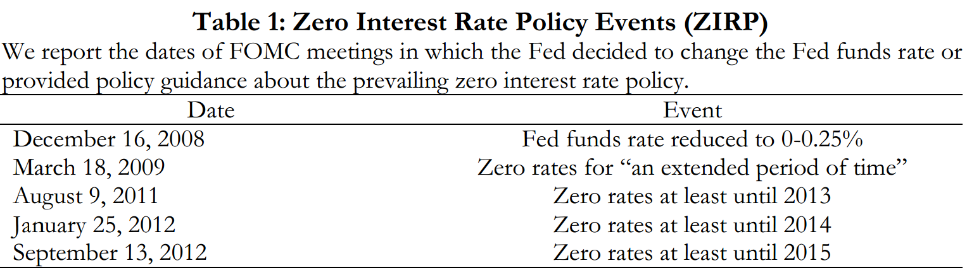
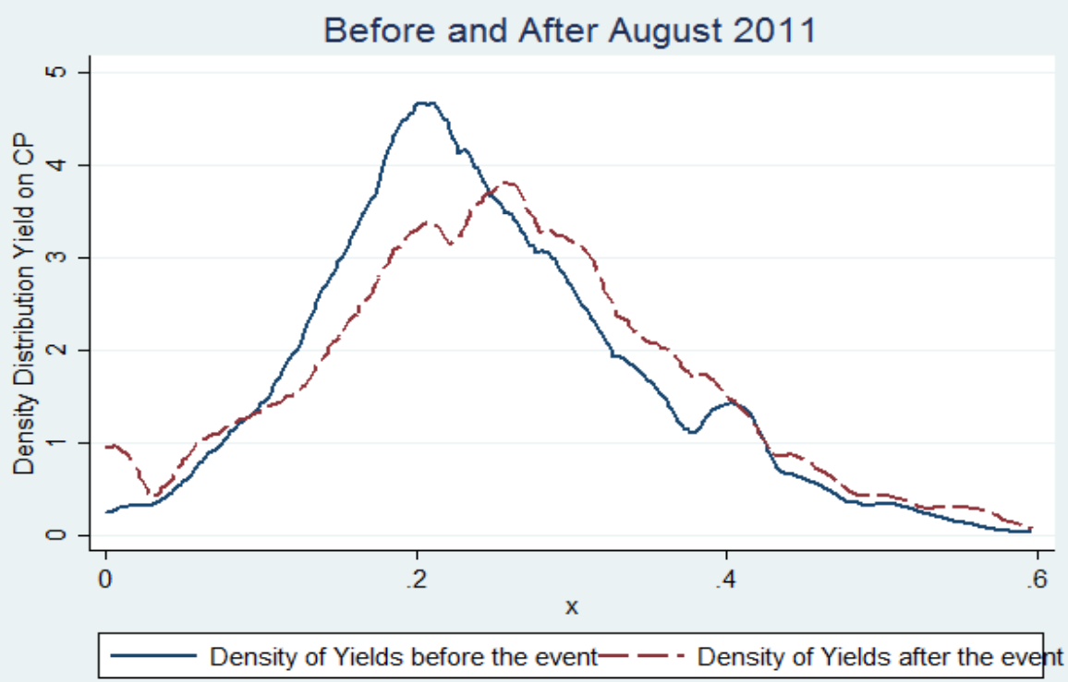
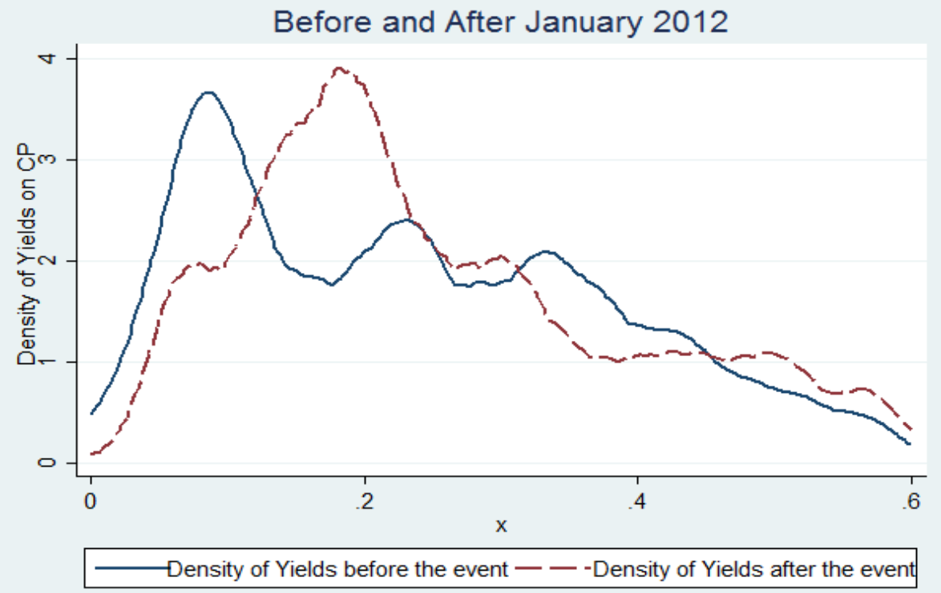
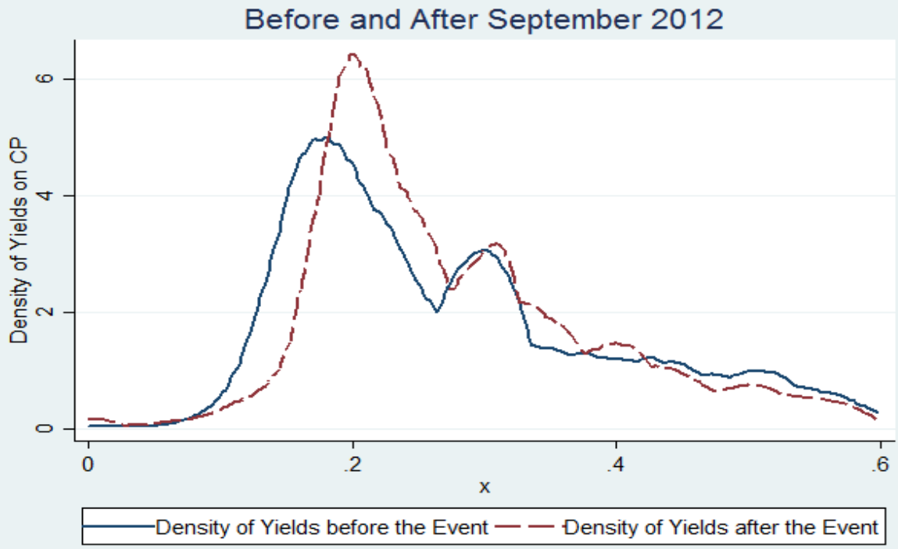
Robustness Checks
2. Evidence from Portfolio Holdings

Slide 35
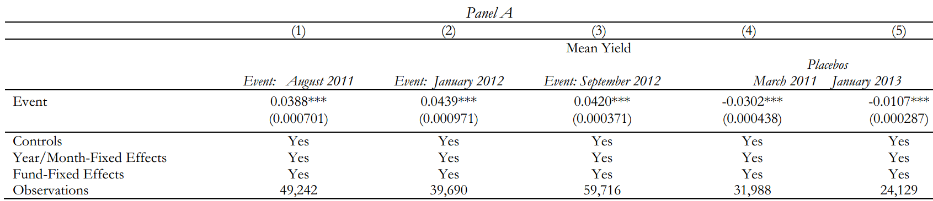
Robustness Checks
In an additional test, the authors examine whether the increase in yields is a function of new additions made by funds to their portfolios after the policy announcement or is a legacy effect of the portfolios formed before the announcement.
where Mean Yield is the average yield of all securities of a given fund at time t
Conclusion:
The coefficient of Event is positive and statistically significant for all three events, which means that the new securities feature significantly higher yields in the post period relative to the pre period.

Slide 36
Robustness Checks
In an additional test, the authors examine whether the increase in yields is a function of new additions made by funds to their portfolios after the policy announcement or is a legacy effect of the portfolios formed before the announcement.
They further assess whether these results are due to monetary policy effects or are a reflection of general macro trends in the data. To this end, the authors design a placebo test in which we estimate a similar regression model for two random event windows, one (March 2011) picked for the period before the first event and one (January 2013) picked for the period after the last event.
Conclusion: The results, in columns (4) and (5), indicate that the average yields on the new securities, if anything, decrease over time when considering these different dates. Hence, it is unlikely that our results are a consequence of a general macro trend.

Slide 37
Conclusion

Slide 38
Conclusion
Due to the financial crisis, monetary authorities worldwide launched a policy of keeping short-term interest rates at record low levels. Some critics have argued that the policy might have led to undesired effects in financial markets. This paper empirically investigates such adverse consequences in the context of money funds (MMFs).
The authors find out that in response to the Zero Interest Rate Policy, MMFs 1) invest in riskier asset classes, 2) hold less diversified portfolios, 3) become more likely to exit the market, and 4) reduce the fees they charge their investors.
Moreover, funds affiliated with large institutions are more likely to exit the market while those independent funds tend to take more risk. This will lead to a negative selection of risky funds in the markets.
Overall, this paper suggests that the zero lower bound policy has had a negative impact on the competitiveness of money fund industry.
Notes:
Because MMFs’ profit margin is seriously weaken due to the ZIRP.

Slide 39
Thank you!
Notes:
Provides us a good example of how to study the impact of financial policy towards individual entities in economy.
In this paper, the authors collect very detailed data and run a lot of regression models to test the significance of each factor and possibility, this help us to understand the impacts in a more quantitative way.
We have learnt from this paper that the low interest rates do have negative impacts on MMFs, because low rates squeeze and narrow the profit margins of MMFs and make them harder to survive in the market. Many of them have to exit the market and find some more favorable targets to make an investments.

Slide 40
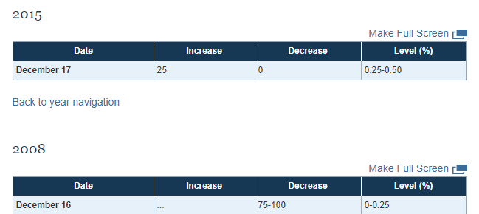

This paper is published in November, 2015. However, Federal Reserve began to raise the interest rate and enter into a new raising-interest cycle in December, 2015…

Slide 41
